Slide 1
MOBILE & SATELITE COMMUNICATION for B TECH II
EMMANUEL EDUSEI ESSEL

Slide 2
TABLE OF CONTENT
MOBILE COMMUNICATION
SATELLITE COMMUNICATION
Electromagnetic Spectrum
Wireless Communications
Introduction to Mobile
Communications
Modulation Basics
Network Parameter
The Cellular Approach
Types of Orbit
Frequency Bands
Parts of Satellite
Satellite Parameters
Link Budget
Satellite Application
Global Positioning System
Overview of VSAT

Slide 3

MOBILE COMMUNICATION

Slide 4
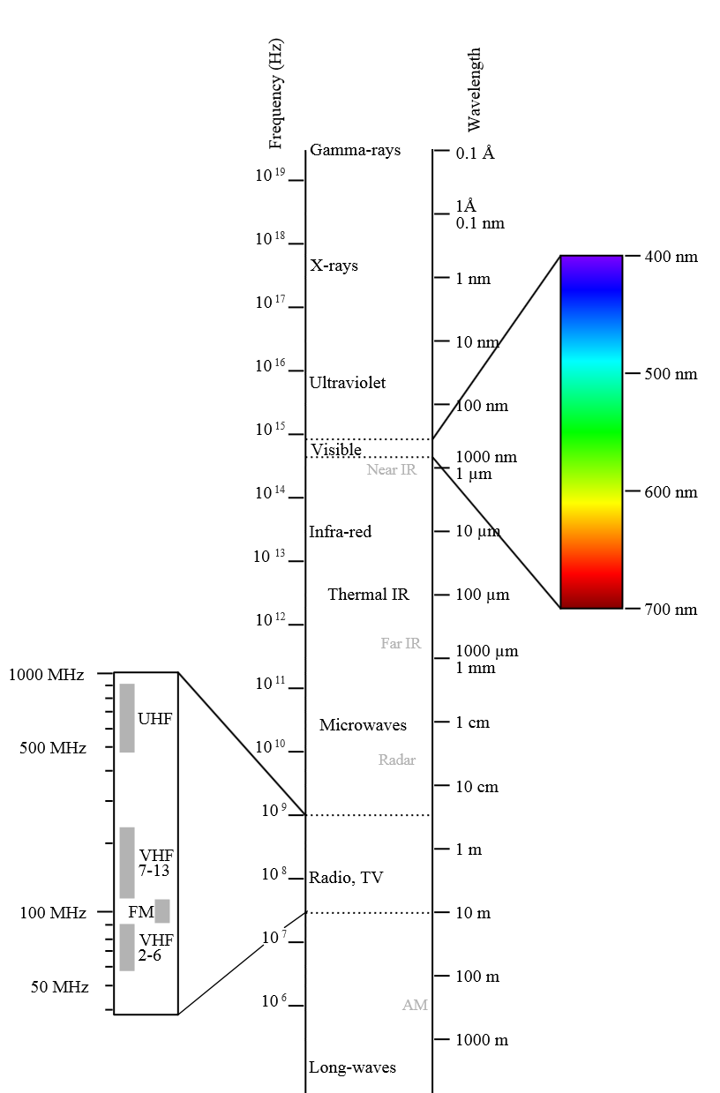
THE ELECTROMAGNETIC SPECTRUM
Electromagnetic waves are typically described by any of the following three physical properties: the frequency f, wavelength λ, or photon energy E.
Frequencies observed in astronomy range from 2.4×10²³ Hz (1 GeV gamma rays) down to the local plasma frequency of the ionized interstellar medium (~1 kHz).
Wavelength is inversely proportional to the wave frequency,^{[5]} so gamma rays have very short wavelengths that are fractions of the size of atoms, whereas wavelengths on the opposite end of the spectrum can be as long as the universe.
C = f λ or E = hc / λ
where:
c = 299792458 m/s is he speed of light in a vacuum
h = 6.62606896(33)×10⁻³⁴ J·
s = 4.13566733(10)×10⁻¹⁵ eV·s is Planck's constant.

Slide 5
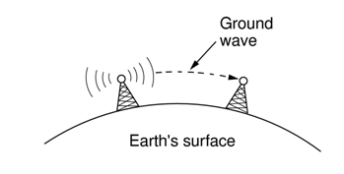
Critical technical bottlenecks in a wireless link are the capacity of the radio channel, its unreliability due to adverse time-varying, multipath propagation and severe interference from other transmissions, in neighboring cells.
A signal radiated from an antenna travels one of three paths
1)Ground wave (below 2 MHz)
2)Sky wave (2 to 30 MHz)
3)Line of sight (above 30MHz)
WIRELESS COMMUNICATION

Slide 6
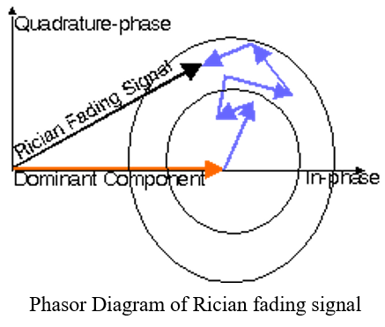
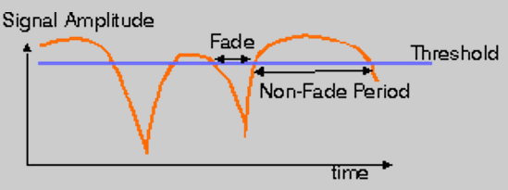
Racian Fading
FADING
Rayleigh Fading
Rayleigh fading is caused by multipath reception. The direct line of sight in mobile environment, between base station and the mobile is not ensured and the signal received at the receiver is the sum of a number of signals reaching through different paths (multipath). Multipath propagation of RF waves is due to the reflection of RF energy from a hill, building, truck, or aero plane etc.; the reflected energy undergoes a phase change also.
The model behind Rician fading is similar to that for Rayleigh fading, except that in Rician fading a strong dominant component is present. This dominant component can for instance be the line-of-sight wave.

Slide 7
INTRODUCTION TO MOBILE COMMUNICATION SYSTEMS
Evolution of Mobile Communication Systems
The evolution of Mobile Communication Systems intensively depends upon:
• Miniaturization of Hardware Technologies.
• Moore’s Law.
• Development in Digital Signal Processing Techniques.
• Digital Switching Techniques.
• Intelligent Spectrum Management Methods.
• Government and Regularity Authorities

Slide 8
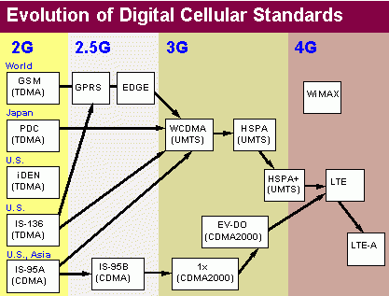

Slide 9
GSM OVERVIEW
If you are in Europe or Asia and using a mobile phone, then most probably you are using GSM technology in your mobile phone.
• GSM stands for Global System for Mobile Communication. It is a digital cellular technology used for transmitting mobile voice and data services.
• The concept of GSM emerged from a cell-based mobile radio system at Bell Laboratories in the early 1970s.
• GSM is the name of a standardization group established in 1982 to create a common mobile telephone standard.
• GSM is the most widely accepted standard in telecommunications and it is implemented globally.
• GSM is a circuit-switched system that divides each 200 kHz channel into eight 25 kHz time-slots. GSM operates on the mobile communication bands 900 MHz and 1800 MHz in most parts of the world. In the US, GSM operates in the bands 850 MHz and 1900 MHz.

Slide 10

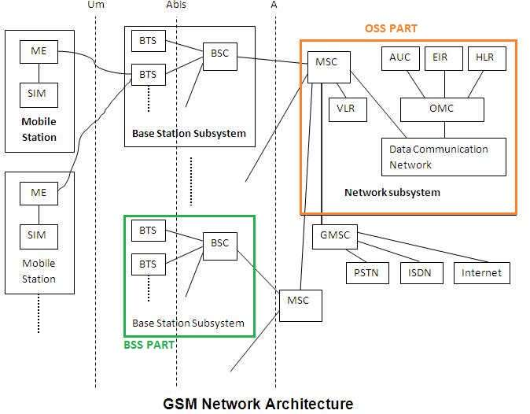
Solar Cell
GSM NETWORK ARCHITECTURE

Slide 11
CELLULAR NETWORK COMPONENTS

Slide 12
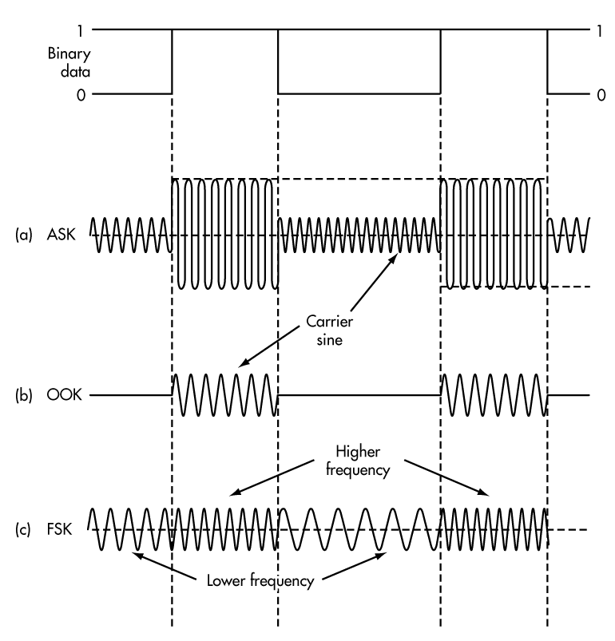
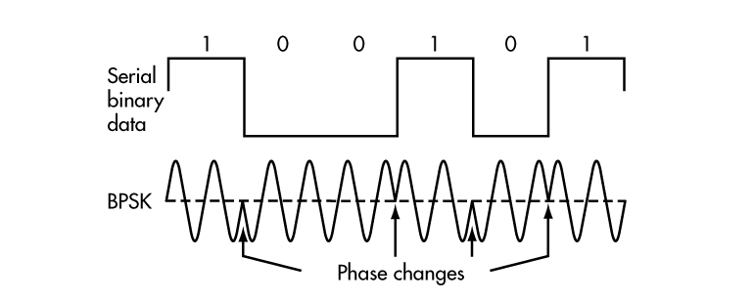
MODULATION
    Modulation is the process of transforming the input data into a suitable format for the transmission medium. The transmitted data is demodulated back to its original form at the receiving end. The GSM uses Gaussian Minimum Shift Keying (GMSK) modulation method.

Slide 13
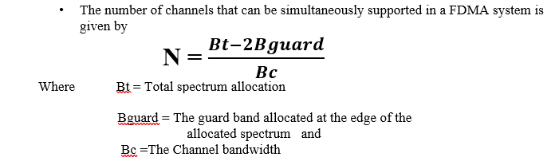
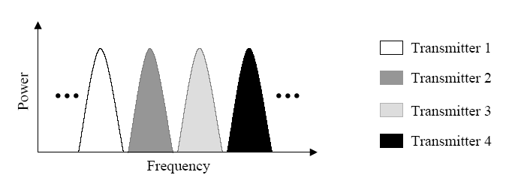
ACCESS METHODS
FREQUENCY DIVISION MULTIPLE ACCESS (FDMA)
Each transmitter is allocated a channel with a particular bandwidth
All transmitters are able to transmit simultaneously
Enable many mobile users to share simultaneously radio spectrum
Provide for the sharing of channel capacity between a number of transmitters at different locations
Aim to share a channel between two or more signals in such way that each signal can be received without interference from another

Slide 14
NETWORK PARAMETERS
Channel Allocation: Channel allocation deals with the allocation of channels to cells in a cellular network. Once the channels are allocated, cells may then allow users within the cell to communicate via the available channels.
Fixed Channel Allocation: Fixed Channel Allocation (FCA) systems allocate specific channels to specific cells. This allocation is static and cannot be changed. For efficient operation, FCA systems typically allocate channels in a manner that maximizes frequency reuse.
Dynamic Channel Allocation: Dynamic Channel Allocation (DCA) attempts to alleviate the problem mentioned for FCA systems when offered traffic is non-uniform. In DCA systems, no set relationship exists between channels and cells.
Hybrid Channel Allocation Schemes: The third category of channel allocation methods includes all systems that are hybrids of fixed and dynamic channel allocation systems.
Dynamic Channel Reassignment: Similar to the goals of dynamic channel assignment is the process of Dynamic Channel Reassignment (DCR). Whereas a DCA scheme allocates a channel to an initial call or handover, a DCR system switches a cell's channel (that is currently being used) to another channel which is closer to the optimum according to frequency reuse or other cost criteria.
A PN junction diode with an intrinsic material in the deletion region is made to encapsulate in a glass.
The light is made to incident on maximum area possible with thin glass on the top so as to collect maximum light with minimum resistance.

Slide 15
CHANNEL CAPACITY
Channel Allocation: Channel allocation deals with the allocation of channels to cells in a cellular network. Once the channels are allocated, cells may then allow users within the cell to communicate via the available channels.
Fixed Channel Allocation: Fixed Channel Allocation (FCA) systems allocate specific channels to specific cells. This allocation is static and cannot be changed. For efficient operation, FCA systems typically allocate channels in a manner that maximizes frequency reuse.
Dynamic Channel Allocation: Dynamic Channel Allocation (DCA) attempts to alleviate the problem mentioned for FCA systems when offered traffic is non-uniform. In DCA systems, no set relationship exists between channels and cells.
Hybrid Channel Allocation Schemes: The third category of channel allocation methods includes all systems that are hybrids of fixed and dynamic channel allocation systems.
Dynamic Channel Reassignment: Similar to the goals of dynamic channel assignment is the process of Dynamic Channel Reassignment (DCR). Whereas a DCA scheme allocates a channel to an initial call or handover, a DCR system switches a cell's channel (that is currently being used) to another channel which is closer to the optimum according to frequency reuse or other cost criteria.
A PN junction diode with an intrinsic material in the deletion region is made to encapsulate in a glass.
The light is made to incident on maximum area possible with thin glass on the top so as to collect maximum light with minimum resistance.

Slide 16
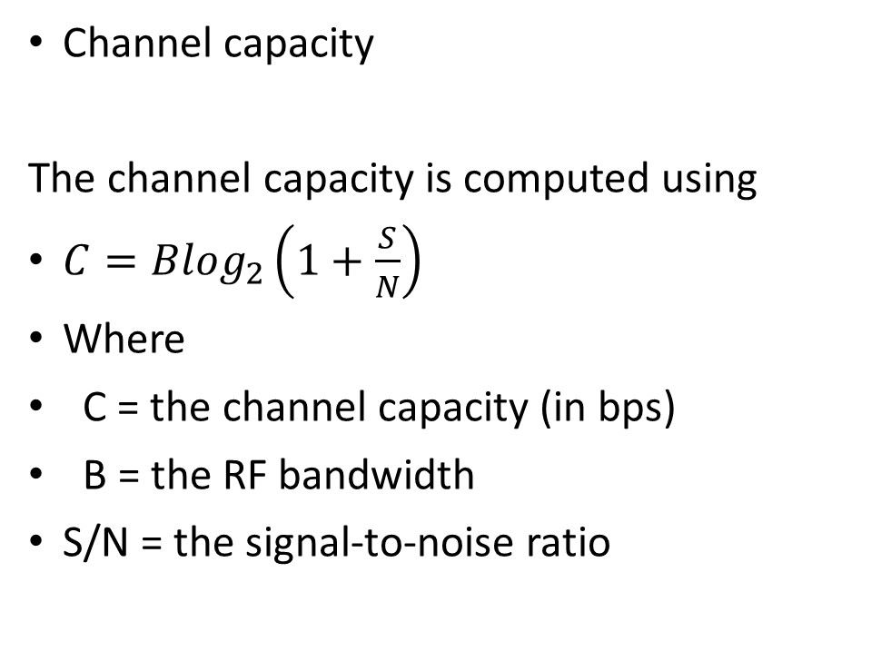
CHANNEL CAPACITY FOR NOISE-FREE CHANNEL
A PN junction diode with an intrinsic material in the deletion region is made to encapsulate in a glass.
The light is made to incident on maximum area possible with thin glass on the top so as to collect maximum light with minimum resistance.
The channel capacity is computed using
Where
C = the channel capacity (in bps)
B = the RF bandwidth
M = the number of discrete signal elements
This is known as the Nyquist channel capacity.
For binary representation , M = 2
Channel capacity
The channel capacity is computed using
$C={Blog}_{2}\left(1+\frac{S}{N}\right)$
Where
C = the channel capacity (in bps)
B = the RF bandwidth
S/N = the signal-to-noise ratio
Example:
–If the signal to noise ratio (SNR) of a wireless communication link is 20 dB and the RF bandwidth is 30 kHz, determine the maximum theoretical data rate that can be transmitted.

Slide 17
CELLULAR APPROACH
With limited frequency resource, cellular principle can serve thousands of subscribers at an affordable cost. In a cellular network, total area is subdivided into smaller areas called “cells”. Each cell can cover a limited number of mobile subscribers within its boundaries. Each cell can have a base station with a number of RF channels.
Some Criteria For The Cell Shapes
1. Geometric shape
2. Area without overlap
3. Area of the cell
Some Eligible Shapes
Square
• Equilateral triangle
• Circle
• Hexagon

Slide 18
Area comparisons
The area of an equilateral triangle to a circle approx = 17.77%
The area of a square to a circle approx = 63.7%
The area of a hexagon to a circle approx = 83%
It means hexagon has the highest coverage area after a circle.
Thus hexagon satisfies all the conditions which is why the shape of a cell is hexagonal in cellular network.
A hexagon layout requires fewer cells to cover a given area. Hence, it envisages fewer base stations and minimum capital investment.
Other geometrical shapes cannot effectively do this. For example, if circular shaped cells are there, then there will be overlapping of cells.
Also for a given area, among square, triangle and hexagon, radius of a hexagon will be the maximum which is needed for weaker mobiles.

Slide 19
Cell Site
A cell site or cell tower is a cellular telephone site where antennae and electronic communications equipment are placed — typically on a radio mast, tower, or other raised structure — to create a cell (or adjacent cells) in a cellular network.
Range
The working range of a cell site (the range which mobile devices connects reliably to the cell site) is not a fixed figure. It will depend on a number of factors
Small Cells
Small cells, which have a smaller coverage area than base stations, are categorized as follows:
• Microcell, less than 2 kilometres
• Picocell, less than 200 metres
• Femtocell, around 10 metres

Slide 20
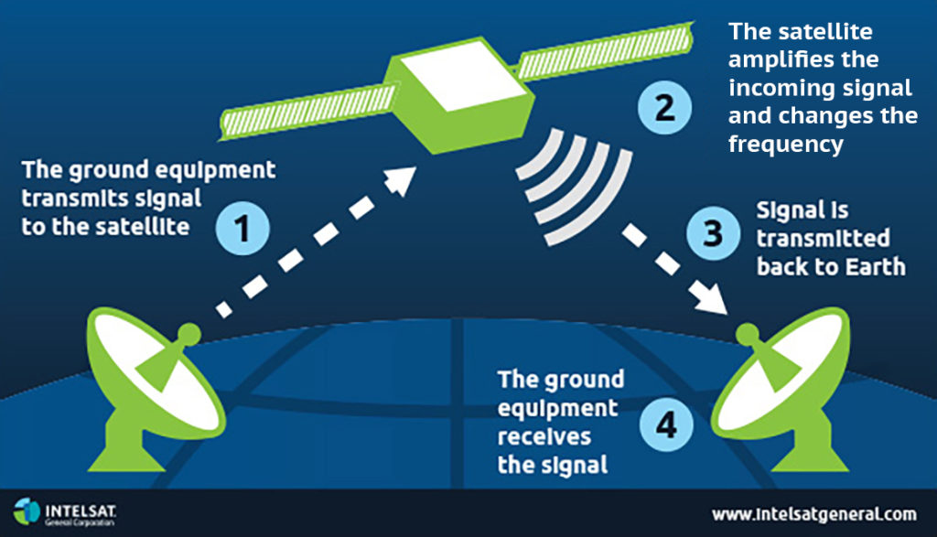
SATELLITE COMMUNICATIONS

Slide 21
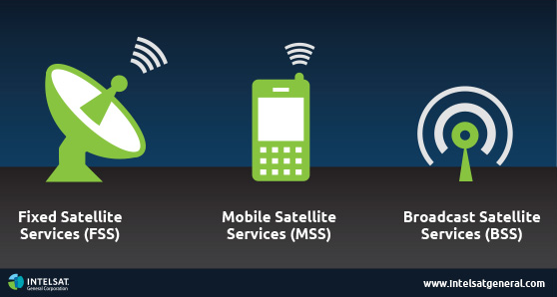
WHAT IS A SATELLITE

Slide 22
WHAT IS A SATELLITE
A satellite is a body at orbits around another body in space. There are two different types of satellites – natural and man-made. Examples of natural satellites are the Earth and Moon. The Earth rotates around the Sun and the Moon rotates around the Earth.
A man-made satellite is a machine that is launched into space and orbits around a body in space. Examples of man-made satellites include the Hubble Space Telescope and the International Space Station.
Artificial satellites are mainly called as communication satellites which are categorized based on coverage service type and their usage. Coverage varies based on beamwidth of the antenna on satellite and can be global regional or national

Slide 23

BENEFITS OF SATELLITE COMMUNICATION

Slide 24
SATELLITE COMMUNICATION
Geostationary Satellite
Geostationary satellite is the most common type of satellite and more popular today. This is located at geostationary circular orbit above earth at about 35,860 Km. GEO satellite's angular speed is same as that of the Earth, it remains at the same position on the equator even if the Earth moves/rotates. Hence GEO satellite is ideal for providing continuous service 24 Hrs of the time.
LEO Satellite
LEO satellite is located at about 500 to 1500 Km altitude. This type of satellite is visible for about 20 minutes from a fixed location on earth. The orbit period is about 1.5-2 Hours. Coverage diameter is approx. 8000Km.
MEO Satellite
MEO satellite is located at the altitude of about 5000 to 12000 Km above earth. The orbit period is about 6 Hours. Coverage diameter is approx. 10000 -15000Km. Round trip delay is about 50ms.
Satellite Bandwidth
As mentioned above, C band Satellite will have about 500 MHz of bandwidth between upper and lower frequency limits. This 500 MHz bandwidth is divided into 12 channels of 36 MHz bandwidth. 4MHz of guard bands incorporated in between this channel to minimize adjacent channel interference.

Slide 25
PARTS OF A SATELLITE
Satellite transponder:
Antenna subsystems:
Solar cell and battery backup
ANTENNA GAIN CALCULATION
The antenna gain is calculated as follows:
Ant Gain = 4 x π x 'efficient area' (dBi)
-----------------------------
wavelength (λ)
π = 3.1415927 approx
'Efficient area' = antenna reflector area x antenna efficiency

Slide 26
SATELLITE APPLICATION
Satellite can provide the right solution for a number of applications, whether extending the edge of the terrestrial networks to remote places or as a stand-alone solution, such as:
• Enterprise Connectivity
• Retail Transactions
• Internet Connections (ISPs)
• Video/TV Direct to Home
• Maritime
• Cellular Backhaul
• Military Defense
• Energy & Utilities
• Oil & Gas
• Business Continuity
• Disaster Recovery/Emergency Relief
• Education & Training
• Aeronautical Connectivity.

Slide 27
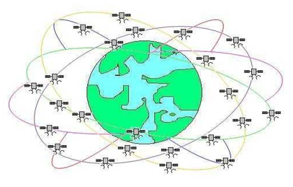
GPS
GPS stands for Global Positioning System. It is mainly used to determine location, speed and time of users on the Earth. This tutorial covers GPS basics, GPS applications, references and provide link to GPS chips/modules manufacturers.
GPS System
The GPS system consists of total 28 satellites orbiting around the earth divided among six different orbits. The satellites are positioned at the height of about 20,180 km. As the orbits, satellites are inclined to about 55 degree with equator. This makes four satellites visible all the time from any location on the earth

Slide 28
GPS
Satellite for Television distribution
Coaxial cables and microwave relay links are used for relaying TV signals from one place to the other. With the help of communication satellites, TV signals are relayed very easily to the home with the help of Dish Antenna
Satellite Phone
The example of satellite phone is the Iridium system comprising 66 satellites revolving 420 miles above the earth. This satellites directly communicate with the handheld cell phones anywhere on the region of the earth. This LEOS(Low Earth Orbiting Satellites) uses L band and digital technology for voice/data communications.

Slide 29
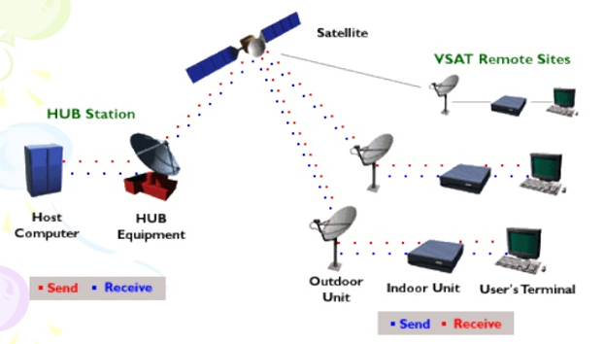
Very Small Aperture Terminal (VSAT)
A very small aperture terminal (VSAT) is a small-sized earth station used in the transmit/receive of data, voice and video signals over a satellite communication network, excluding broadcast television. A VSAT consists of two parts: a transceiver placed outdoors in direct line of sight to the satellite, and a device that is placed indoors to interface the transceiver with the end user’s communications device, such as a PC

Slide 30


